Slide 1
The Entity Relationship Data Model

Slide 2
What is an ER Diagram?

Slide 3
What is an ER Diagram?
ER diagrams are used to sketch out the design of a database. By defining the entities, their attributes, and showing the relationships between them, an ER diagram illustrates the logical structure of databases.

Slide 4
Features of an Entity-Relationship Model
1. Graphical Representation for Better Understanding – It is really straightforward and easy to comprehend, so developers can use it to interact with stakeholders.
2. Database Design – This approach is extensively used in database design the database designers in the creation of databases.
3. ER Diagram – The ER diagram is a visual representation of the model.

Slide 5
ER diagram has three main components:
Entity
Attribute
Relationship

Slide 6
Entity
Any object that physically exists and is logically constructed in the real world is called as an entity. It is a real-world object that can be easily identifiable. An entity is represented as a rectangle in an ER diagram.

Slide 7

Example :
In an organization, employees, managers, and projects assigned can be considered entities. All these entities have some attributes or properties that give them their identity.

Slide 8
Entity Types :
Strong Entity – Strong entities are those entity types that have a key attribute. The primary key helps in identifying each entity uniquely. this can not accept null values so it can not be a unique key. It is represented by a rectangle.

Slide 9
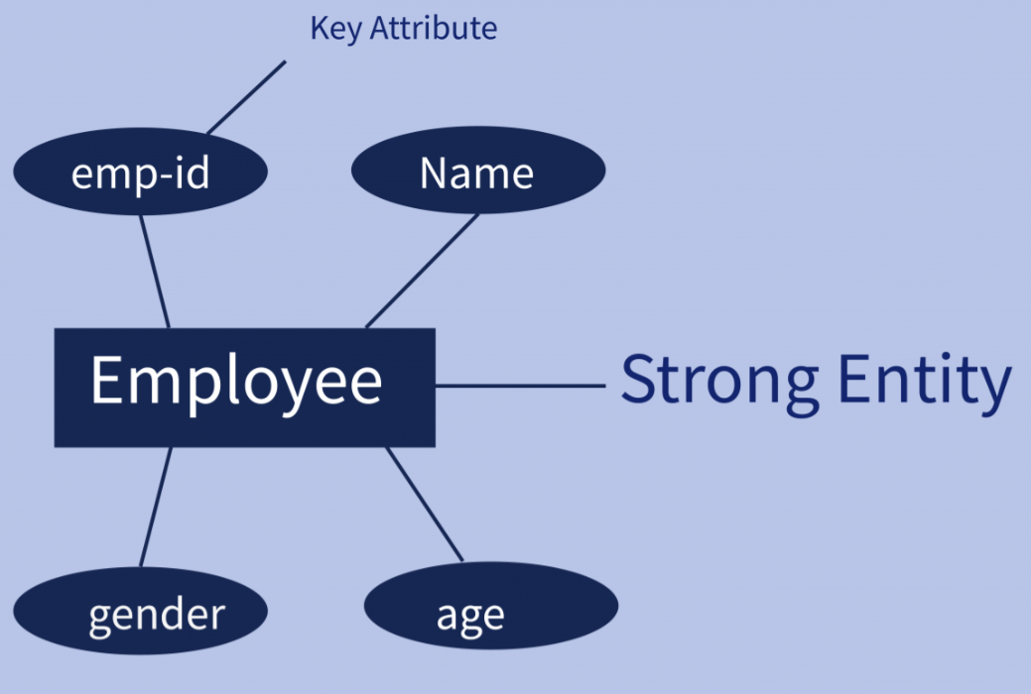
Example :
in an example of organization emp_id identifies each employee of the organization uniquely and hence, we can say that employee is a strong entity type.

Slide 10
Entity Types :
Weak Entity – Weak entity type doesn’t have a key attribute. Weak entity types can’t be identified on their own. It depends upon some other strong entity for its distinct identity. A weak entity is represented by a double outlined rectangle. The relationship between a weak entity type and strong entity type is shown with a double outlined diamond instead of a single outlined diamond. This representation can be seen in the example given below.

Slide 11
Attribute :
An attribute is a property or characteristic of an entity. An entity may contain any number of attributes.

Slide 12
There are Six such types of attributes:
Simple attribute
Composite attribute
Single-valued attribute
Multi-valued attribute
Derived attribute.
Stored attribute.

Slide 13
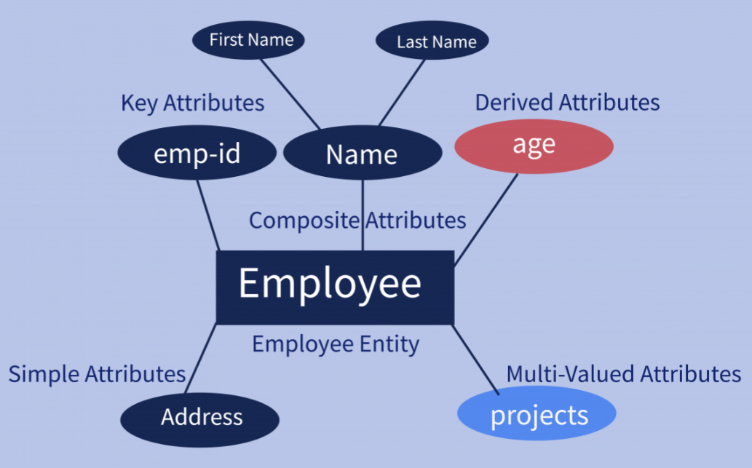

Slide 14
Relationship :
A relationship in a DBMS is primarily the way two or more data sets are linked. Relationships allow the datasets to share and store data in separate tables. They also help link disparate data with each other.
Relationships are of three types

Slide 15
Types of Relationship :
One to One
One to Many
Many to Many

Slide 16

One to One – It is used to create a relationship between two tables in which a single row of the first table can only be related to one and only one record of a second table. This relationship tells us that a single record in Table A is related to a single record in Table B. And vice versa

Slide 17
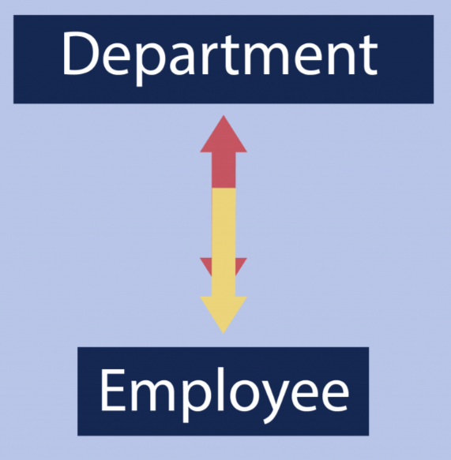
One to Many – It is used to create a relationship between two tables. Any single row of the first table can be related to one or more rows of the second table, but the rows of the second table can only relate to the only row in the first table. It is also known as a many-to-one relationship.

Slide 18
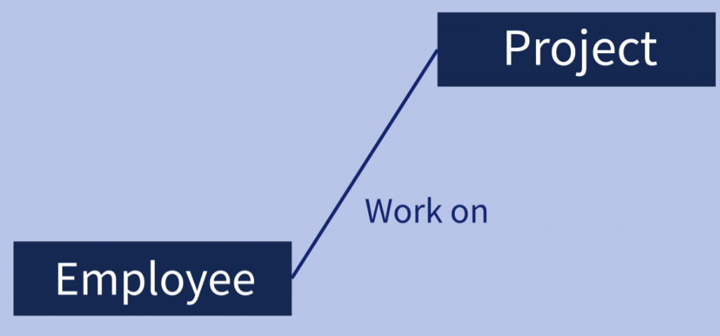
Many to Many – Many to many relationships that create a relationship between two tables. Each record of the first table can relate to any records (or no records) in the second table. Similarly, each record of the second table can also relate to more than one record of the first table. It also represented an N:N relationship.

Slide 19
Why Use ER Diagrams ? :
It helps you to define terms related to entity relationship modeling.
It provides a preview of how all your tables should connect, what fields are going to be on each table
It helps to describe entities, attributes, relationships.
ER diagrams are translatable into relational tables which allows you to build databases quickly.
ER diagrams can be used by database designers as a blueprint for implementing data in specific software applications.

Slide 20
ER Diagram of Hotel Management System

Slide 21
ER Diagram of Library Management System

Slide 22
ER Diagram of Banking System

Slide 23
ER Diagram of Online Shopping System

